Slide 1
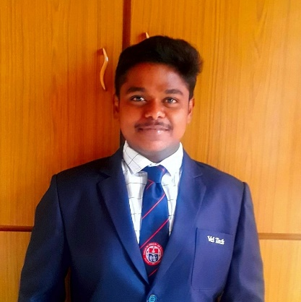


NETTURI MANOJ KUMAR
Analyst/Software Engineer
I Transform L&D Left Shift Batch
Bachelor of Technology,
Mechanical Engineering: 2018-22
Certificate : AZ-900 Fundamental
Skills
netturimanoj24@gmail.com
C# | Basics, OOPS, Exception Handling ,Arrays ,Collection and Generics, Delegates and Events, File Io and Serialization.
.NET Framework | ADO.NET, ASP.NET with MVC 5 and WEB API, ENTITY FRAMEWORK
Ado.net | Basics Architecture
Database | SQL
Tools | GIT, SWAGGER
UI Technology | HTML5 ,CSS & Angular
Add On Skills | Work Priority Management, Leadership, Communication Skills, Team Management, Self-assessment.
+91 9652909089
A4
Full Stack Developer
Understanding of RDBMS concepts using SQL Server
Practical understanding of C# and SQL concepts using Visual Studio and SQL Server
Hands on experience in developing applications using .NET Framework, ADO.NET Core, ASP.NET and JWT based authentication
Understanding of HTML5 , CSS and Angular CLI
Check out my GitHub Repository
ONLINE FLIGHT BOOKING SYSTEM
Case study of Online Flight Booking System along with API Gateway, Swagger, payment, JWT Based Authentication ,responsive UI with HTML5, CSS, Bootstrap and Angular used as User Interface. This application enables a customer to book a flight reservation in advance and can cancel the booking or Check in into the flight and also an admin user can perform various administrative operations like Airport management, Flight Management and Customer management.
Technologies used:
ANGULAR
ASP.NET CORE WEB API
Microsoft SQL Server
Video Link: Click Here
https://github.com/sdsameer07

